Slide 1
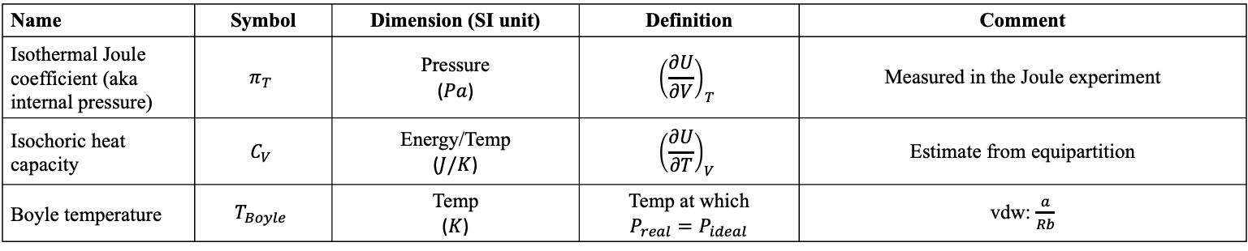
Summary of measurable quantities
Name | Symbol | Dimension (SI unit) | Definition | Comment
Isothermal Joule coefficient (aka internal pressure) | $$π_{T}$$ | Pressure ($Pa$) | $${\left(\frac{∂U}{∂V}\right)}_{T}$$ | Measured in the Joule experiment
Isochoric heat capacity | $$C_{V}$$ | Energy/Temp ($J/K$) | $${\left(\frac{∂U}{∂T}\right)}_{V}$$ | Estimate from equipartition
Boyle temperature | $$T_{Boyle}$$ | Temp ($K$) | Temp at which $$P_{real}=P_{ideal}$$ | vdw: $\frac{a}{Rb}$

Slide 2
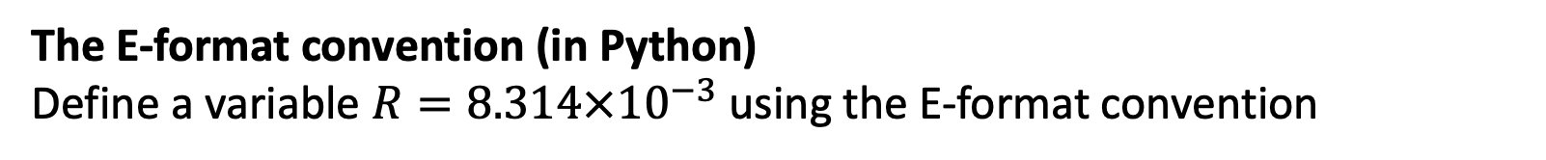
The E-format convention (in Python)
The E-format convention (in Python)
Define a variable $R=8.314×{10}^{−3}$using the E-format convention
Notes:
Week 1

Slide 3
Variables with units (in Python)
Use AssignQuantity to define the variable $R=8.314×{10}^{−3}\frac{kJ}{mol K}$
Notes:
Week 1

Slide 4
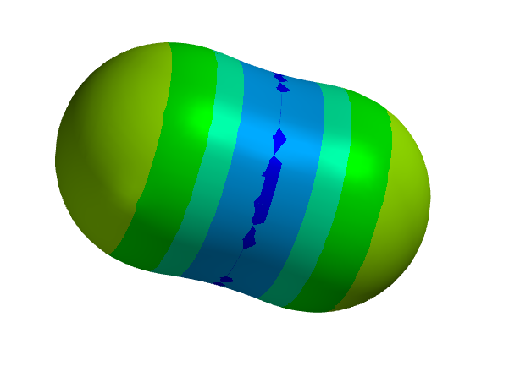
Intermolecular bond strengths, part 1 (Spartan)
What’s the meaning of the colors in this electrostatic potential map of $CO_{2}$?
Notes:
Week 1

Slide 5
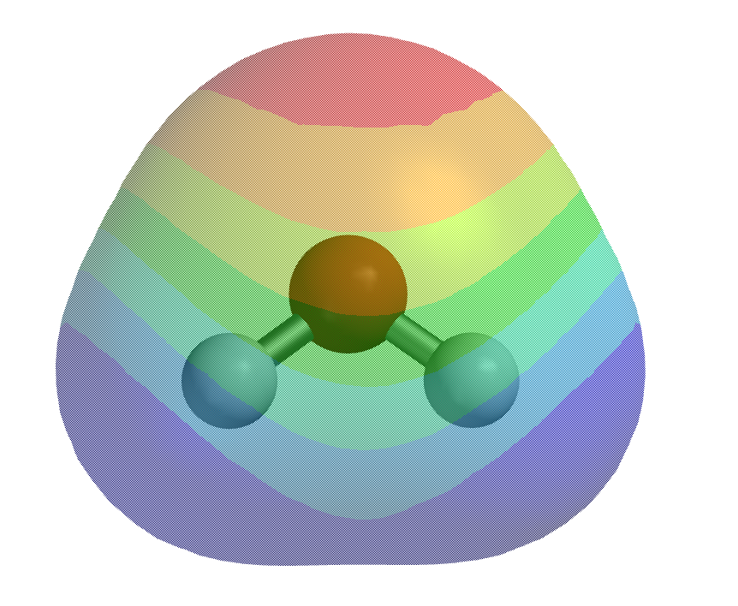
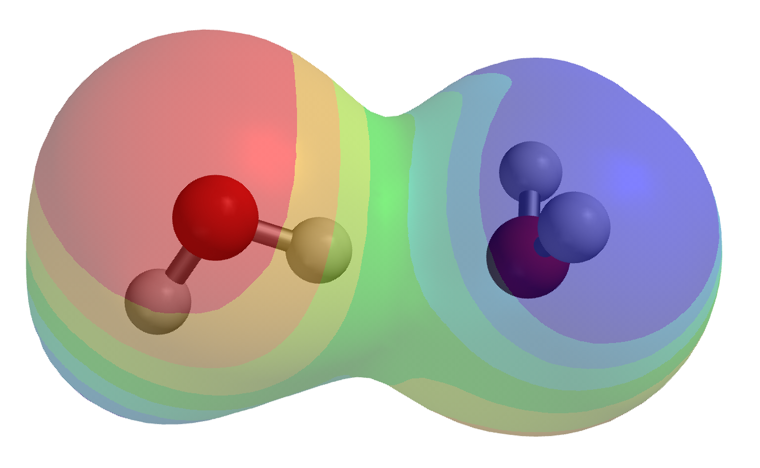
Intermolecular bond strengths, part 2 (Spartan)
How would you use Spartan to get the bond strength holding two water molecules together?
Notes:
Week 1

Slide 6
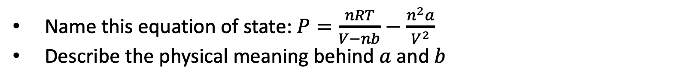
Equations of state
Name this equation of state: $P=\frac{nRT}{V−nb}−\frac{n^{2}a}{V^{2}}$
Describe the physical meaning behind $a$ and $b$
Notes:
Week 1

Slide 7
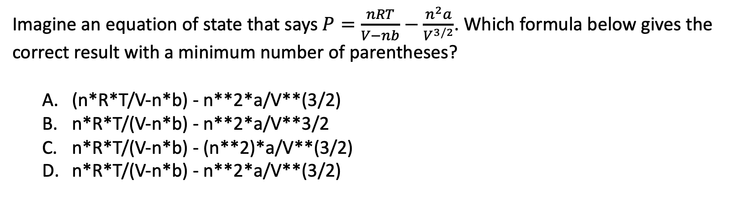
Order of operations
Imagine an equation of state that says $P=\frac{nRT}{V−nb}−\frac{n^{2}a}{V^{3/2}}$. Which formula below gives the correct result with a minimum number of parentheses?
(n*R*T/V-n*b) - n**2*a/V**(3/2)
n*R*T/(V-n*b) - n**2*a/V**3/2
n*R*T/(V-n*b) - (n**2)*a/V**(3/2)
n*R*T/(V-n*b) - n**2*a/V**(3/2)
Notes:
Week 1

Slide 8
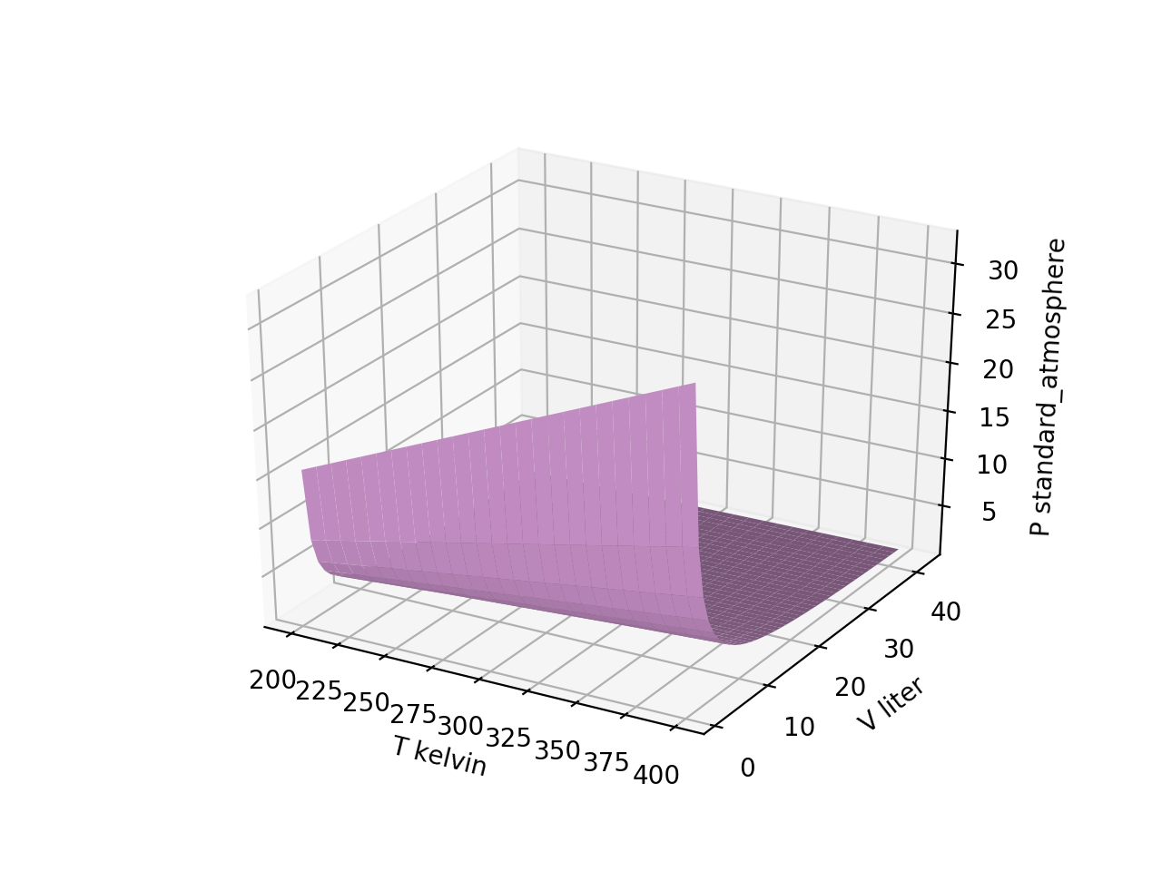
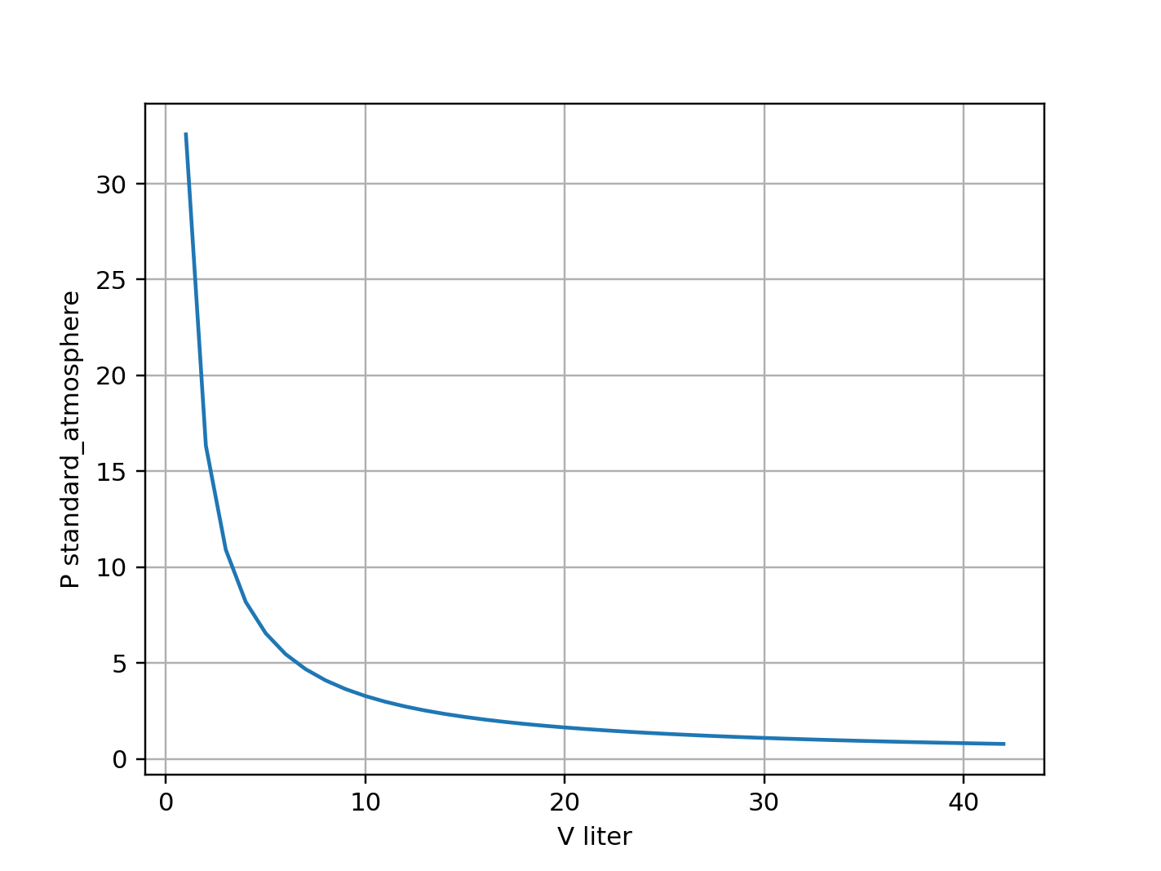

Slicing
Assuming grids have been organized in the way we’ve been doing it, which might give you the curve shown on the right?
$$P(T,V)$$
Pgrid[:,-1]
Pgrid[-1,:]
Pgrid[-1,-1]
Pgrid[:,:]
Notes:
Week 2

Slide 9
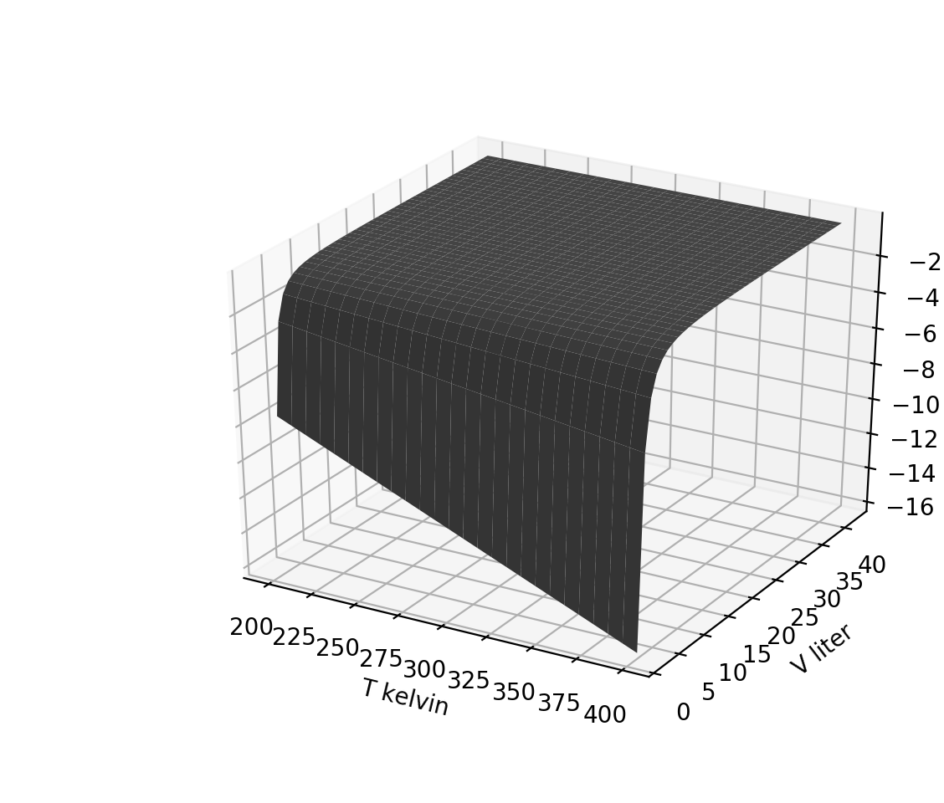
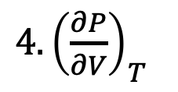
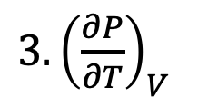
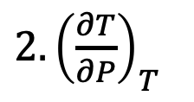
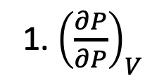
Partial derivatives (slopes) of thermodynamic surfaces, part 1
Assuming ideal gas behavior, which surface could the one on the right be?
1. ${\left(\frac{∂P}{∂P}\right)}_{V}$
$2. {\left(\frac{∂T}{∂P}\right)}_{T}$
${3. \left(\frac{∂P}{∂T}\right)}_{V}$
${4. \left(\frac{∂P}{∂V}\right)}_{T}$
Notes:
Week 2

Slide 10
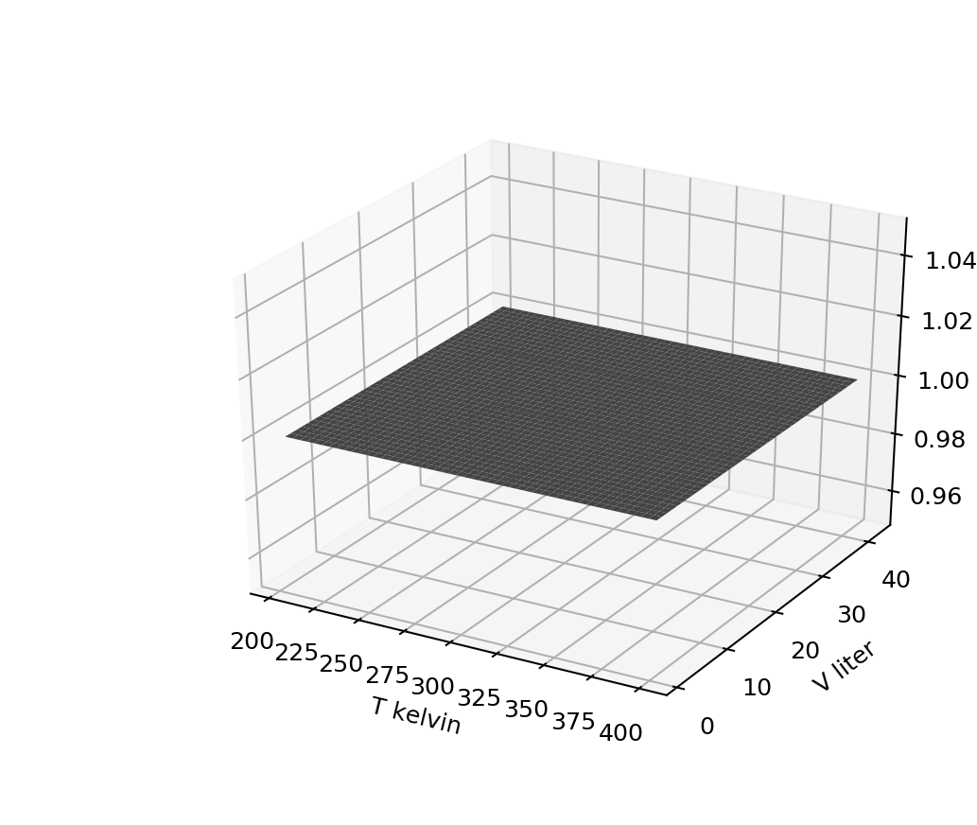
Partial derivatives (slopes) of thermodynamic surfaces, part 2
Assuming ideal gas behavior, which thermodynamic surface could this be?
1. ${\left(\frac{∂P}{∂P}\right)}_{V}$
$2. {\left(\frac{∂T}{∂P}\right)}_{T}$
${3. \left(\frac{∂P}{∂T}\right)}_{V}$
${4. \left(\frac{∂P}{∂V}\right)}_{T}$
Notes:
Week 2

Slide 11
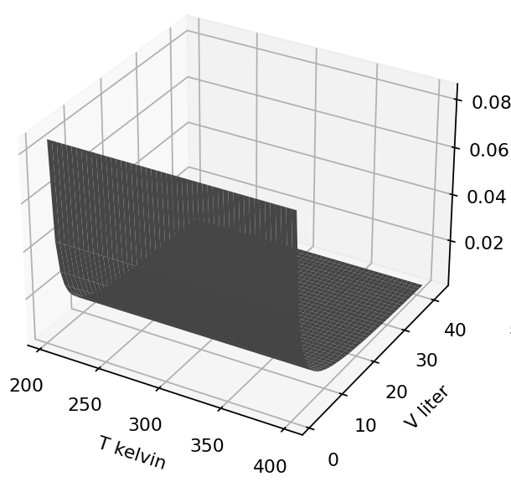
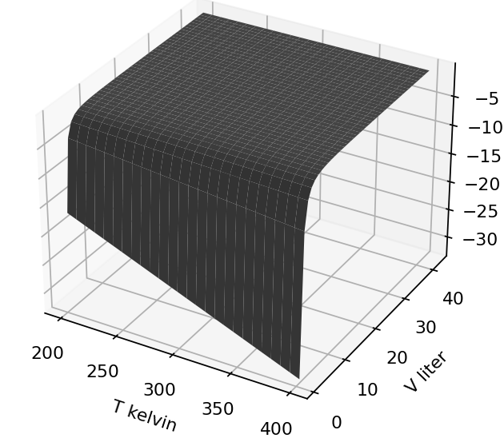

Calculus of partial derivatives
Suppose $P=\frac{nRT}{V−nb} −\frac{n^{2}a}{V×(V−nb)}$. Find the algebraic expression corresponding to one of these (your choice):
${\left(\frac{∂P}{∂T}\right)}_{V}=$
${\left(\frac{∂P}{∂V}\right)}_{T}=$
Notes:
Week 2

Slide 12
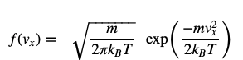

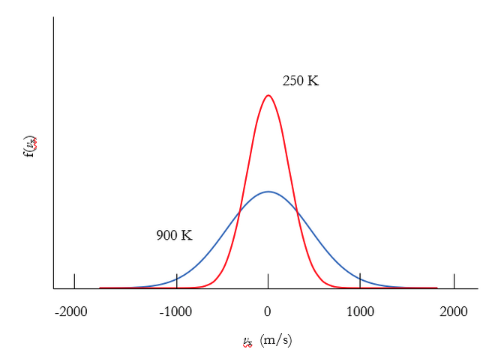
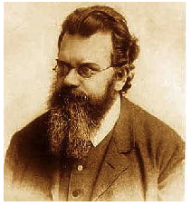

Probability densities, part 1
What are the units of $f(v_{x})$?
$$v_{x} (\frac{m}{s})$$
Notes:
Week 3

Slide 13
Probability densities, part 2
Which graph below corresponds to the lighter molecule?
$$v_{x} (\frac{m}{s})$$
Notes:
Week 3

Slide 14
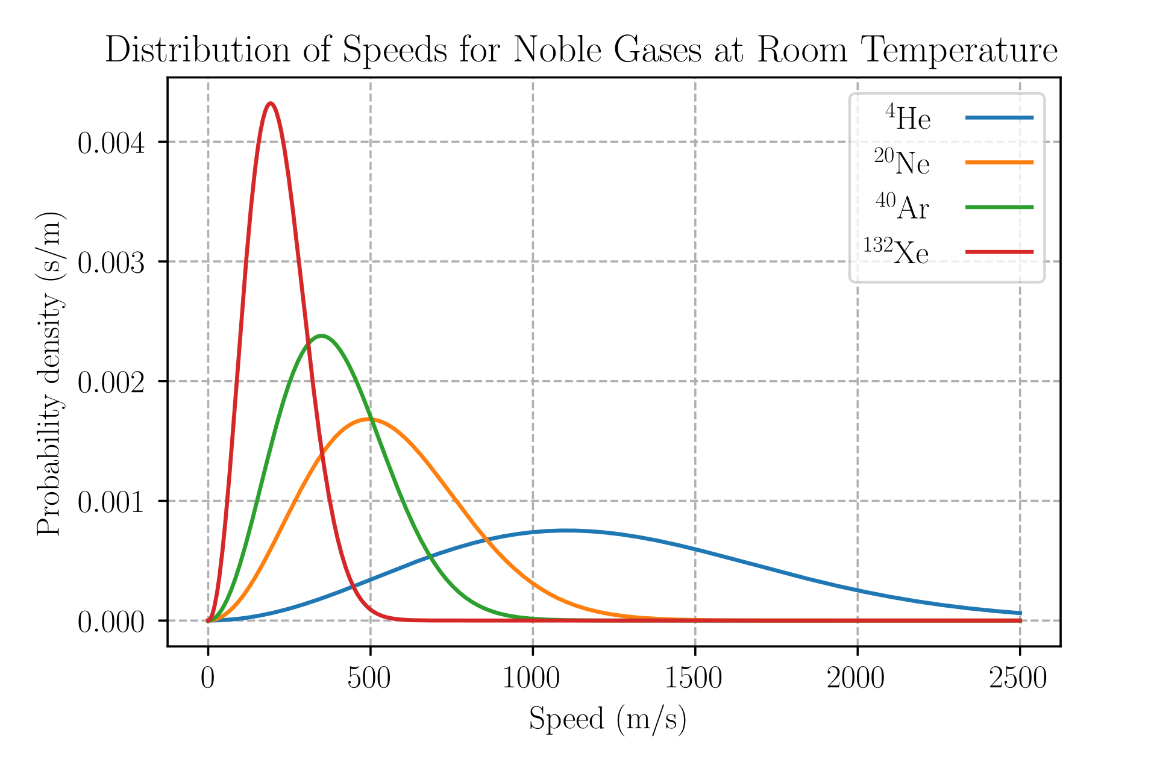
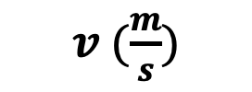
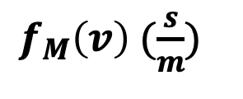
Probabilities from probability densities
What’s the probability (as a fraction, and also in %) of finding a Neon gas atom with speed between 740 m/s and 760 m/s?
$f_{M}\left(v\right)$ $(\frac{s}{m})$
$v (\frac{m}{s})$
Notes:
Week 3

Slide 15

Analytical moments of the speed
Which Gaussian integral below would you use to find $<v^{2}>$?
$$f_{M}=N_{M}v^{2}\exp\left(−Dv^{2}\right)$$
Notes:
Week 3

Slide 16
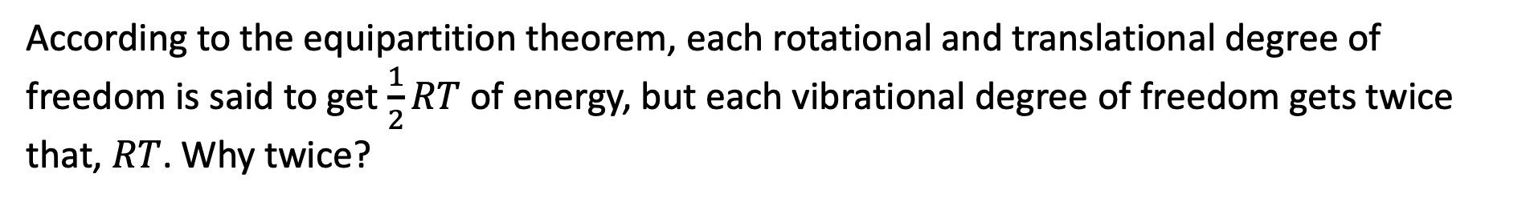
Equipartition
According to the equipartition theorem, each rotational and translational degree of freedom is said to get $\frac{1}{2}RT$ of energy, but each vibrational degree of freedom gets twice that, $RT$. Why twice?
Notes:
Week 4

Slide 17

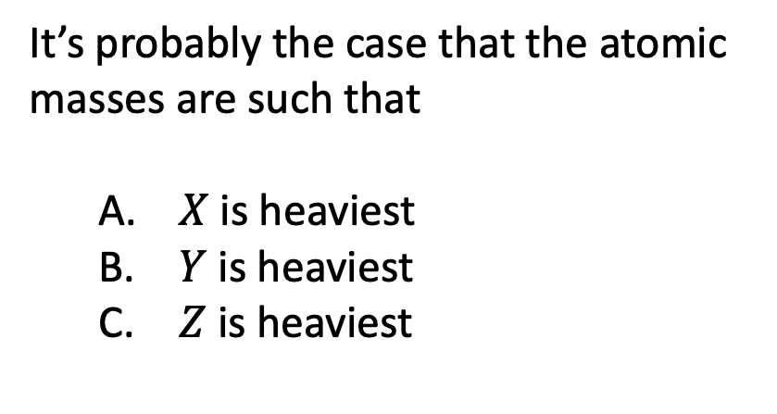
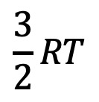


Heat capacities, part 1
It’s probably the case that the atomic masses are such that
$X$ is heaviest
$Y$ is heaviest
$Z$ is heaviest
$$\frac{3}{2}RT$$
$$X_{2}$$
$$Y_{2}$$
$$Z_{2}$$
Notes:
Week 4

Slide 18
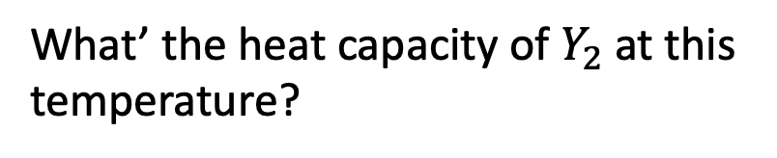
Heat capacities, part 2
What’ the heat capacity of $Y_{2}$ at this temperature?
$$\frac{3}{2}RT$$
$$X_{2}$$
$$Y_{2}$$
$$Z_{2}$$
Notes:
Week 4

Slide 19
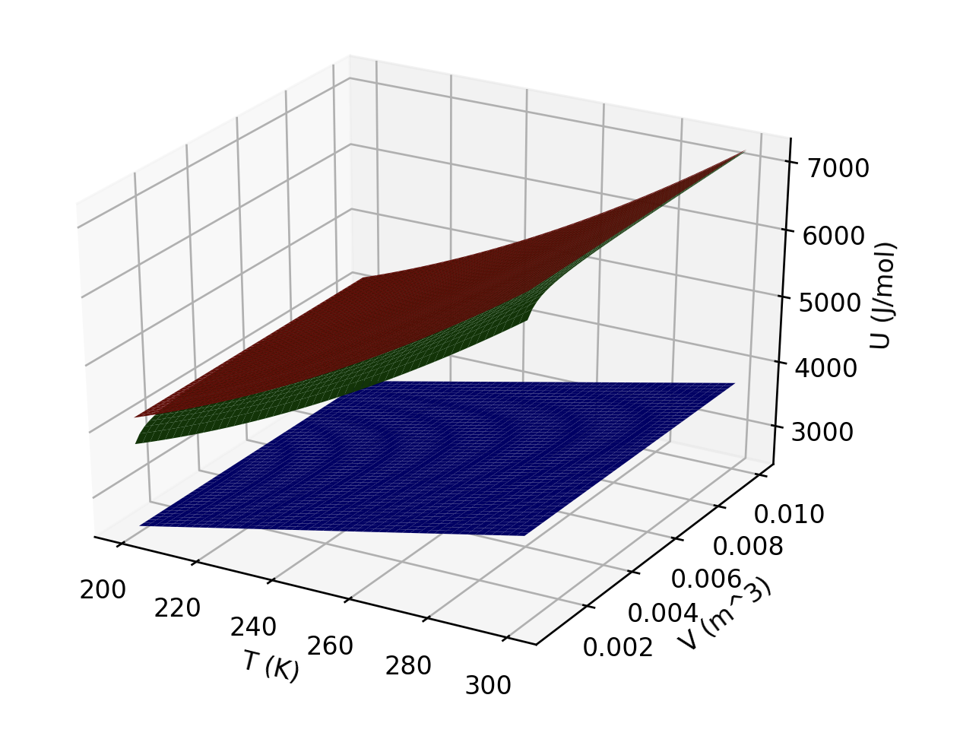
Interpreting U(T,V)
What is responsible for the curvature of the red and green gases in the temperature direction?
Which gas(es) could be ideal?
Which is/are probably monatomic?
Notes:
Week 4

Slide 20
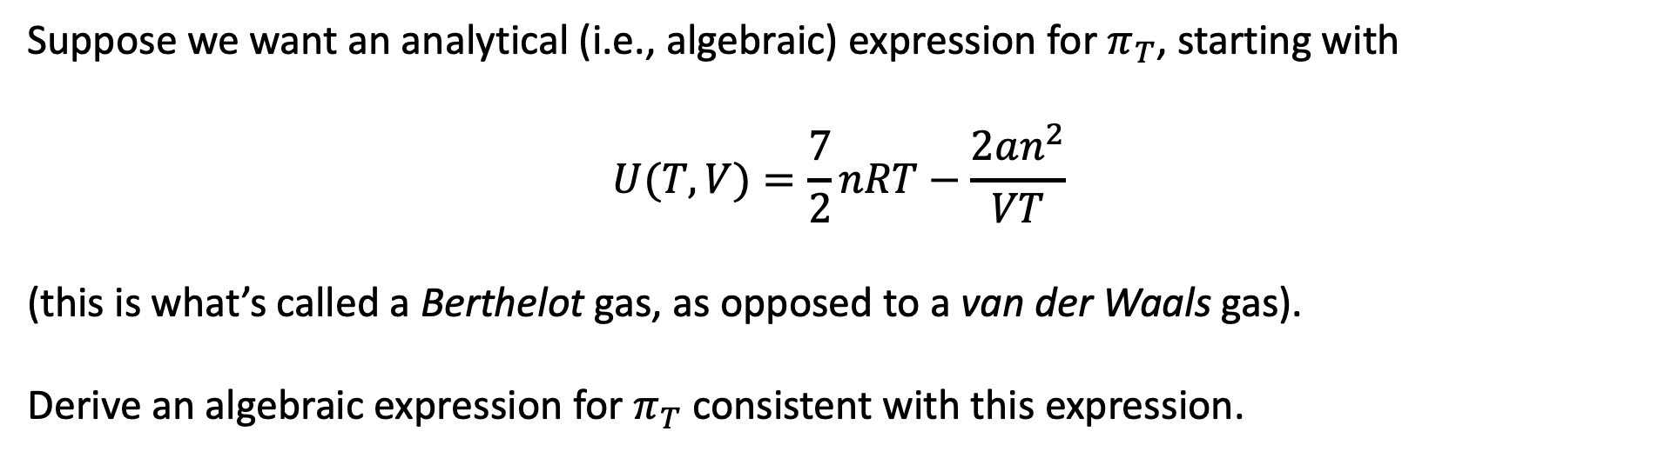
Analytical $π_{T}$
Suppose we want an analytical (i.e., algebraic) expression for $π_{T}$, starting with
$$U(T,V)=\frac{7}{2}nRT−\frac{2an^{2}}{VT}$$
(this is what’s called a Berthelot gas, as opposed to a van der Waals gas).
Derive an algebraic expression for $π_{T}$ consistent with this expression.
Notes:
Week 4

Slide 21
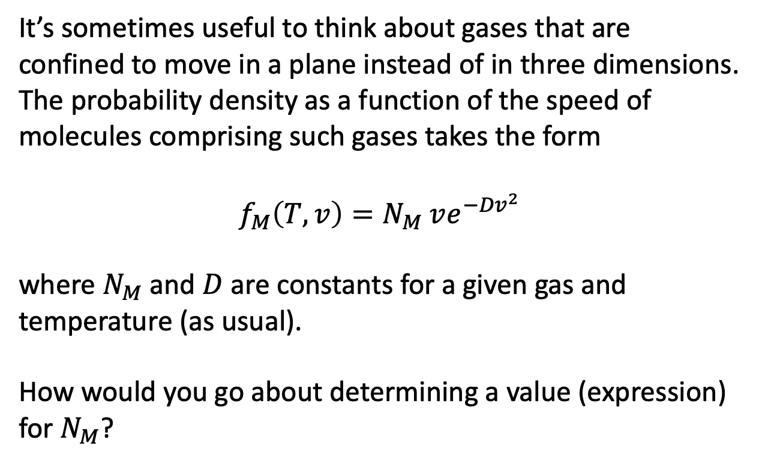
Normalization of a speed probability density
It’s sometimes useful to think about gases that are confined to move in a plane instead of in three dimensions. The probability density as a function of the speed of molecules comprising such gases takes the form
$$f_{M}\left(T,v\right)=N_{M} ve^{−{Dv}^{2}}$$
where $N_{M}$and $D$ are constants for a given gas and temperature (as usual).
How would you go about determining a value (expression) for $N_{M}$?
Notes:
Week 4

Slide 22
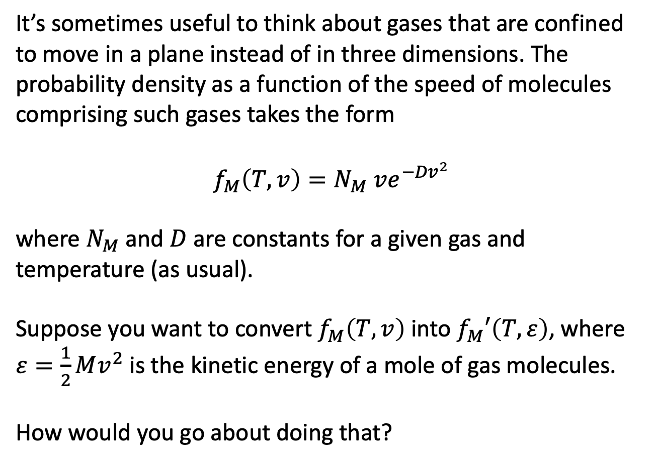
Probability densities of kinetic energy
It’s sometimes useful to think about gases that are confined to move in a plane instead of in three dimensions. The probability density as a function of the speed of molecules comprising such gases takes the form
$$f_{M}\left(T,v\right)=N_{M} ve^{−{Dv}^{2}}$$
where $N_{M}$and $D$ are constants for a given gas and temperature (as usual).
Suppose you want to convert $f_{M}\left(T,v\right)$ into $f_{M}′\left(T,ε\right)$, where $ε=\frac{1}{2}Mv^{2}$ is the kinetic energy of a mole of gas molecules.
How would you go about doing that?
Notes:
Week 4

